Slide 1
Appdynamics Engineer Training: Chapter 5 Architecture
Notes:
Welcome to the AppDynamics Engineer training program! My name is Sandro Guglielmin, I am responsible for the technical enablement our Partners and I will walk you thru this chapter.
We will discuss AppDynamics itself, it’s architecture and components and add some understanding for the technologies used by it.
take your time to complete this chapter and understand it thoroughly. Feel free to submit questions to by email should you have any questions or have problems with viewing any part of the content.

Slide 2
What’s this about?
We will take a look at AppDynamics itself. Understand the components, their deployment architecture and technologies used.
Notes:
AppDynamics brings APM to production environments. In order to do so it needs to scal and adapt to wide variety of application deployments. We will take a look a the components of AppDynamics and understand how they allow for scalability as well as giving visibility into the application runtime environment. One aspect we will highlight is the form of communication betwenn components chosen by AppDynamics and we’ll discuss iboth it’s advantages as well as is’t consequences.

Slide 3
Overview
AppDynamics Components
Controller
Application Agent
Machine Agent
Communication
Sizing
Backup/Failover
Notes:
Here is an overview of the topics discussed in this chapter.
We will discuss in Detail each of the components of AppDynamics, the Controller, Application Agent and Machine Agent.
Then we discuss the communication methodology between these components as it gives interesting insights in how the Solution works a s a while system.
We will also spend some time to discuss hardware sizing aspects of the controller and discuss the available back up and failover options.

Slide 4
The Components at a Glance
Controller
Data Aggregation and RollUp
Data Persistance
Rule evaluation
Application Agent
Discovery
Metrics/Thresholds
Snapshots
Machine Agent
Resource Utilization
Extensibility
Flash based UI
Monitoring / Root Cause Analysis
HTML5 Custom Dashboards
Java Application Server
Legacy Application
AppServerAgent
Server
Java Application Server
AppServerAgent
MachineAgent
MachineAgent
MachineAgent
AppDynamics Controller
AppDynamics Web UI (Flash)
AppDynamics Data Repository
AppDynamics Custom Dashboards HTML5
Notes:
Here is an overview of the Components of AppDyamics.
We will discuss them one by one right after this but this picture should give you a summary overview of a full deployment. How Agents, inserted into application runtimes, communicate with a central server over a network to deliver performance metrics and diagnostic data.
This data is managed and persisted by the server, the controller, and made accessible to an end user thru a Web based Flash UI. There really are only these few components to AppDynamics, the controller, Application Agents and Machine Agents. This makes for a simple deployment which can easily be mapped to different application architectures, deployed in data centers or the cloud or a blend of the two. Since the Agent is just a single java library it’s deployment can be automated with the same tools one uses for automated change management and deployment of application resources, such as Chef or Puppet.

Slide 5
The Controller
Controller
Central repository
GlassFish J2EE
mySQL
Dedicated Server
IO intensive
Receives Data from Agents periodically
Aggregates and persists data to time series
Executes Health Rules and Policies
AppDynamics Controller
AppDynamics Data Repository
Notes:
As mentioned before the Controller is the centralized repository of AppDynamics. It is a single installation that installs both the controller application as well as a mySQL database instance as the controller’s persistence layer.
The database administration tasks are automated, other than backup there are no special maintenance tasks and as such the controller should be considered a single ‘black box’ that runs on dedicated Hardware.
It is also possible to obtain the controller as a Service form AppDynamics if that is a preferable deployment option.
In that case AppDynamics Agents will be deployed with an Application and communicate over the internet to a Software as a Service Controller managed by AppDynamics. We will talk later in more details about the communication paradigm between Agents and Controller, but suffice to say for now that deployment of agents across the internet is a viable option and as such also enables the deployment in a number of cloud architecture scenarios.
It should be noted that the Controller is a very IO intensive application and to meet the demand a set of hardware requirements have been specified. We will take a look at those when looking the controller sizing chart later on in this chapter, let me just say at this point that you should in any case consider a dedicated server to run the controller.

Slide 6
The ApplicationServer Agent
On Java
Conforms to JVMTI
Java 1.5 or higher
Injected into runtime at startup -javaagent:/../javaagent.jar
Uses bytecode instrumentation
On .NET
corresponding technology available on Windows platform, although implementation is different, functionality is same
and soon … on PHP
Java / Linux / Windows
.NET/ Windows
Java Application Server
Internet Information Server
AppServerAgent
Application Pool
AppServerAgent
Pure Java Application
Application Pool
AppServerAgent
AppServerAgent
AppServerAgent
MachineAgent
Coordinator Service / MachineAgent
BT / Backend
Discovery
Monitoring
Correlation
JVM /.NET
Runtime monitoring
JMX / PerfMon
Notes:
We explained in the previous chapter already in detail what the application agent does at the functional level, so we will not repeat it here. Please turn back to that chapter should it not be clear.
From a deployment perspective the Java application agent is implemented conforming to the JVMTI specification. That specification allows for the addition of the addition of software libraries to the runtime at startup, thus no changes to and re-compilation of the application source code are required.
The JVMTI is in effect since Java Version 1.5 and that is why AppDynamics does not support any earlier version of Java. Simply put if you have an opportunity with Java 1.4 or less, you do not have an opportunity. It is part of the scoping process to qualify an opportunity at the technical level to make sure that requirements like this are met.
Once the agent is injected into the JVM at start up it will start threads executing separately from the application, to communicate with the controller, to register business transactions, to record a snapshot for a slow request. So there is activity by the agent, but this activity is not proportional to the application throughput. Other, legacy APM tools produce performance metrics that is proportional to the application load, more throughput equals more overhead and more network usage.
The agent uses byte code instrumentation as specified with the JVMTI to add entry points and exit calls to requests and thus identify a transactional context. Again, these terms have been introduced in the previous chapter. By using byte code instrumentation for transaction identification only, and not to provide visibility as other APM tools do, we can decouple the APM overhead from the application throughput.
In steady state, that is when there are no snapshots recorded and again remember, we only capture snapshots for slow requests, the footprint of the agent should be no more than 10 MB of heap space allocated. During snapshot recording this consumption can go up, but since he creation if snapshots is typically very short-lived that heap space is freed by the very nex minor garbage collection cycle. Any evidence of the Appdynamics agent running in a JVM is usually no more than a slightly shorter interval between minor gc cycles.
While the technolgy implementation and terminolgy n the .NET enviornment is different, the actual functionality, the ability to instrument application code pot compilation, is quite similar. WE will therefore not go into the specific differences in the agent implenentation for .NET at this point except for pointing out one important difference. While in Java with version 1.6 the ability to dynamically re-instrument code at runtime has been made reliable, this capability remainsinaccessible in .NET, therefore changing configurations that affect instrumentation will require a .NET application to be restarted in order for those configurations to take effect.

Slide 7
The Machine Agent
Collects System Resource Utilization
CPU, Network IO, Disk IO
Extensible via scripting
Task Manager
Executes Scripts as triggered by Controller Automation
Legacy Application
Server
MachineAgent
MachineAgent
Notes:
The Machine Agent is run as a separate OS process. It is itself a small java application and its means of communication with the controller is the same as with the Application Agent. It has 2 essential functionalities it is scheduler as well as a task Manager.
The scheduler executes OS Scripts to collect system resource utilization metrics that are displayed in the Hardware tab at the node level in AppDynamics dashboards. These metrics are collect with the hardware monitor scripts that come with the Machine Agent installation. You can find those scripts in the appropriate Machine Agent subdirectory. You can also create your own scripts and have them be scheduled for execution. If formatted appropriately, output from those scripts can be uploaded to the controller and become metrics like any other metric managed with AppDynamics. It is thus as easy as writing a custom OS script to extend the reach of AppDynamics to create additional metrics. There is detailed documentation available on how to write such scripts, please refer to docs.appdynamics.com for further details. Note that the Machine agent like the Application agent provides 1 minute level resolution, thus if your script executes more than once a minute the aggregated metrics will be uploaded to the controller.
The Task Manager function is essentially the executing arm of AppDynamics’ Automation capabilities. You can create Policies and health rules that can trigger actions in AppDynamics and there is a separate Chapter dedicated to this capability. Suffice to say at this point that the Machine Agent is the execution engine of these actions so that they can be executed anywhere in a distributed environment.

Slide 8
Agent-Controller Communication
Periodical communication, once-a-minute
http/https Request/Reply same as Browser/WebServer
Snapshots are sent when created
Caches near full capacity
Nothing stored locally on Disk
Easy outbound port configuration thru firewalls
Guarantees extreme scalability
Small network bandwidth usage
Decoupling of amount of monitored data from application throughput
Java Application Server
Java Application Server
AppServerAgent
AppServerAgent
Java Application Server
Java Application Server
Java Application Server
AppServerAgent
AppServerAgent
AppServerAgent
AppDynamics Controller
AppDynamics Data Repository
Notes:
Let’s now take a detailed look at the agent controller communication
The most important thing to understand is that this communication is not continuous, it is periodical, set to a 1 minute interval. This interval can not be changed and there is good reason for that. The communication is a simple http request/reply, always initiated by the agent.
(Click, play animation)
The agent opens a connection, sends the accumulated performance data since the last communication, receives configuration changes if any have been set since the last communication and then closes the connection. This form of communication dramatically reduces network overhead and network bandwidth consumption, compared to a always-on, 2 way, kept-alive communication that other APM tools have.
As a consequence the controller becomes much more scalable, with the ability to support literally thousands of agents. Compare it to the Browser-webserver communication that essentially drives the Internet and you’ll see it is the same form of communication. Because of this an AppDynamics agent can very much be living in the cloud and connect to a controller physically located anywhere. It is this flexibility that makes cloud deployment options possible. Our biggest customer Netflix, operates over 10000 agents that all connect to 1 controller. Neflix operates its Service out of Amazon EC2, it is the most impressive example of a scaled, cloud based deployment of a APM solution yet.
We think these gains are worth a lot and have chosen this form of communication knowing there is a price to pay. That price is that the data in the user interface is not immediately updated. There is a at least 1 minute delay between the current status of the application and what is represented in the UI. That is a fact, but again we think it is a small price to pay for the scalability and flexibility gains we get in return.
A multi hundred agent deployment of a distributed application in the cloud that is monitored 24 by 7 will not be possible except with the capabilities AppDynamics offers, and in such situations, and the future direction of application architecture points all but in this direction, there really is no alternative.

Slide 9
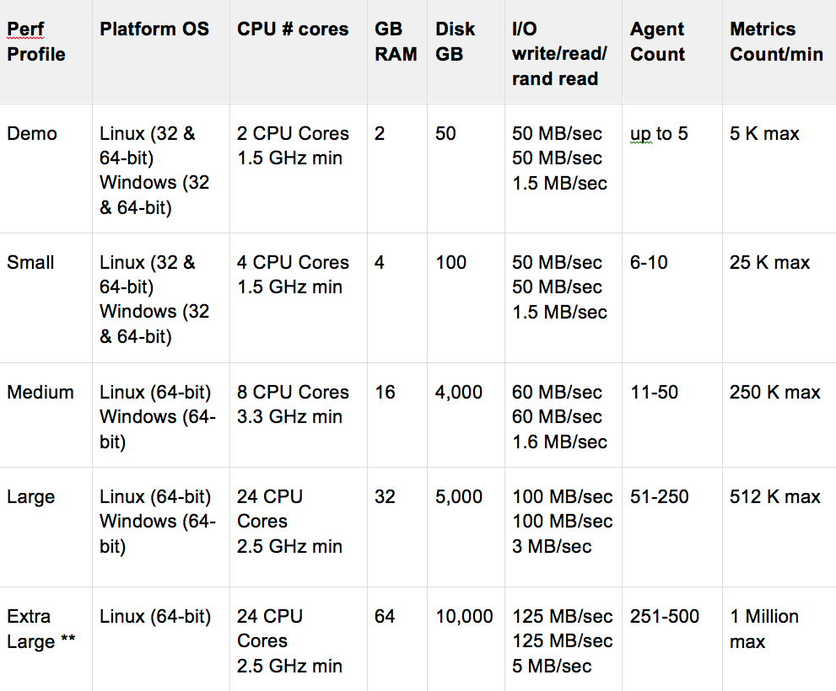
Controller Sizing
Controller
Performance Profiles
Hardware Resources
CPU, memory
Disk IO
Disk space for 1 year of performance data
Notes:
Let’s now take a look the hardware requirments for the controller. The example I gave before obviously requires a appropriate server, which also means that smaller deployments do not require as much hardware resources. These resources are usual suspects, memory, cpu cores, disk space and disk IO spead and bandwith, you remember I mentioned that the controller is a very IO intensive application.
This matrix gives you an indication of the required resources. For the most current version please see the documentation at docs.appdynamics.com. We have made this matrix simple and defined what we call performance profiles. These profiles essentially are based on number of agents and number of metric per agent. It should give you a feel for the required hardware for a controller that needs to support X agents. There is a calculator available on the Field Enablemenent Zone, the FEZ, to which as an SE you have access to, to help in case of large or complex deployments.
If you check this matrix and you notice for example that we specify 5000 GB disk space for a Large deployment then yes that’s 5 TB. If this seems a lot to you then please consider that this is to maintain performance data for up to 250 agents for up to a full year. These specifications are on the conservative side and are calculated based on the controller default settings which retain performance metrics for 365 days. If your prospect decides that there is need for that long of a rolling monitoring window and stipulates for example that 90 days are enough then that can be configured and the data footprint on disk will be obviously be less.
Let me however make it clear and plain that a controller needs to be appropriately sized. An undersized controller will likely cause problems. These problems can result in very long User Interface response times and at worst cause gaps in metric series calculation as the controller is not able to keep up with the incoming requests.
As an SE managing a PoC it is your responsibility to make sure that the controller specifications are met. Propose a saas based PoC as alternative if there are problems to procure appropriate hardware.

Slide 10
Back Up – Failover
Backup
Start/Stop - copy of data directory
Continuos Operation
Hot Backup
Use tools that allow binary backups (not mysqldump)
mylvnbackup, Xtrabackup, INNODB Hot Backup, ZFS snapshost Incremental backups
High Availability / Failover
Load Balancer maintains keep-alive connections
Primary/Secondary Controller Servers
Database synchronization thru replication
Notes:
As mentioned before, Backup is really the only regular maintenance operation required with the controller.
On a small system that is not always on simply stopping the controller, copying the data directory and restarting the controller may suffice.
In a continuous operation this may not be an option. Fortunately since the data repository is a mySQL database, there are plenty of utilities available to take hot backups while mySQL is running. We recommend xtrabackup and instructions on its use are available at docs.appdynamics.com. This tool will create incremental backups, this we recommend a schedule of full backups and incremental backups to achieve data security.
The controller can also be installed in Failover mode. Essentially this means that 2 controllers are deployed with one declared Primary and the other secondary. The secondary, or slave controller will be monitoring the Primary, or Master, controller and should it fail step in and take over. The controllers databases are kept in sync thru replication. This is a active/passive deployment, the secondary controller does not perform actual work unless in case of an issue with the Primary Controller

Slide 11
Summary
In this lesson we learned
The architecture of AppDynamics
Its components and how they are deployed.
The base technologies employed to achieve the required functionalities
The communication paradigm between agents and controllers and the benefits it provides
Details about appropriately sizing the controller
And back up and failover implementation and and practices.
Notes:
Read from slide
Feel free to repeat this chapter should there be any aspect that is no clear to you. Do so befre you start the next chapter. Thank You for your time and attention

